Slide 1


Deep Learning
Assignment 1
Seo Shin Youn (S10205100K)
DL P03 April 2022 - Mr. Mike Wee
Notes:
[Speaker: Seo Shin Youn]
Presentation Link:
https://connectnpedu.sharepoint.com/:v:/s/Testing776/EeucoKJrE5RHkP_fbfoyWUEB1b7R_IkyBQ97QxwHFSal8Q?e=iSzkT0
A very good morning, afternoon, or evening Mr Mike and fellow classmates. My name is Shin Youn, and I will be presenting to you my Deep Learning Assignment 1 Project which consist of defining the image classification problem we intend to tackle; building, optimizing and analyzing the various convolutional neural networks created, as well as evaluating the performance of the respective model in order to identify the best model to test on real-life images.

Slide 2
Deep Learning Presentation Link:
https://connectnpedu.sharepoint.com/:v:/s/Testing776/EeucoKJrE5RHkP_fbfoyWUEB1b7R_IkyBQ97QxwHFSal8Q?e=iSzkT0

Slide 3

TABLE OF CONTENTS
Content Overview
01
Problem, Objective, and Approach
Chosen CNN models to be utilized
Model Evaluation
04
Model Performance Comparison on test images
Model Recommendation
Data Loading & Preprocessing
02
How the images are split in terms of training, validation, and testing dataset
How data is loaded into the environment
Image Preprocessing procedures
Real-life images Classification
05
Understanding how to apply the model
On real life images
Analyzing model prediction
Image Classification Models
03
Building, Optimizing and Analyzing:
Model trained from scratch
Pre-trained models
Notes:
[Speaker: Seo Shin Youn]
For this presentation, I will be covering the agenda and scope of work that I have done, the data loading and preprocessing procedures that I have taken, as well as the various pre-trained models we have built alongside models built from scratch. Following, we would evaluate the models based on a common performance measure before testing the recommended model on real-life images.

Slide 4
Content Overview
01
Understanding the problem, objective and approach alongside an overview of the CNN models chosen
Notes:
[Speaker: Seo Shin Youn]
Now, I will be sharing more about how we intend to tackle the multi-class image classification problem in the context of the food dataset provided.

Slide 5



Overview - Problem, Objectives, Approach
Problem Understanding
Main Objective
Approach
To Perform Multi-Label image classification on 10 different food items and NOT Multi-Class image classification
Assigning each image to multiple labels of differing probability
Build Convolutional Neural Network models including models built from scratch and pre-trained model in order to identify the model with the best performance
Data Loading & Preprocessing
→
Building and Optimizing 1 CNN model trained from scratch and 3 Pre-trained models
→
Identify model with best performance and test on real-life images
Notes:
[Speaker: Seo Shin Youn]
The purpose of this report seeks to provide readers a comprehensive understanding of how Convolutional Neural Networks could be utilized to perform multi-Class image recognition in the context of food items. As a common misconception, unlike a multi-class Image Classification which seeks to assign each sample to only one label the problem we are trying to tackle as part of this project involves multi-label classification problem whereby, we would be able to get multiple labels as output,Hence, by splitting the dataset into its training, validation, and testing datasets, the objective of this project would be to classify the following food items including apple_pie, club_sandwich, grilled_cheese_sandwich, guacamole, pancakes, pizza, prime_rib, risotto, seaweed_salad, and spring_rolls through the utilization and optimization of models built from scratch alongside the usage of pre-trained models. The approach of the following project would thus firstly encompass data loading whereby we will store our base directory, train directory, validation directory and test directory alongside data preprocessing where we intend to transform the raw images to obtain optimal model performance. Following, to develop the image classification models, we will be building a model trained from scratch, alongside 3 Transfer Learning models encompassing VGG19 – a convolutional neural network that is 19 layers deep, MobileNet – a convolutional neural network designed for mobile and embedded vision applications, and InceptionResNetV2 – a convolutional neural network that builds on the Inception family of architectures but incorporates residual connections. Subsequently, to evaluate which of the following multi-label image classification model we have created would yield the best results, we will be utilizing testing accuracy on our test dataset to determine the best model before using it to make a prediction on unseen images from the internet. Hence, this would allow us to summarize our findings and make recommendations on further improvements to the model that could have potentially been made.

Slide 6
Overview of Pre-Trained Models Covered
VGG19 - A convolutional neural network that is 19 layers deep
Inception ResNet V2 - A convolutional neural network that builds on the Inception family of architectures but incorporates residual connections
MobileNet - A convolutional neural network designed for mobile and embedded vision applications
Notes:
[Speaker: Seo Shin Youn]
Following, to develop the image classification models, we will be building a model trained from scratch, alongside 3 Transfer Learning models encompassing VGG19 – a convolutional neural network that is 19 layers deep, MobileNet – a convolutional neural network designed for mobile and embedded vision applications, and InceptionResNetV2 – a convolutional neural network that builds on the Inception family of architectures but incorporates residual connections. As to optimize the model that has been trained from scratch, some of the techniques that will be utilized as part of this project would include utilizing more Conv2D layers which aids in increasing validation accuracy, alongside adding Batch Normalization layers and Drop Out layers which would assist in reducing overfitting. Additionally, image augmentation techniques would be utilized to increase the number of images observed each epoch which would also increase both accuracy and reduce overfitting. As to optimize the various pretrained models, we would utilize techniques including freezing the convolutional base, which would prevent their weights from getting updated during training, performing image augmentation which would assist in increasing both accuracy and reduce overfitting, alongside fine-tuning layers that encode more specialized features by unfreezing them instead. Furthermore, besides the various optimization technique previously discussed exclusive to each model, we would also be performing hyperparameter tuning and configuring different batch sizes.

Slide 7
Data Loading & Preprocessing
02
Understanding how the dataset is being split and loaded into the environment alongside image preprocessing procedures taken
Notes:
[Speaker: Seo Shin Youn]

Slide 8
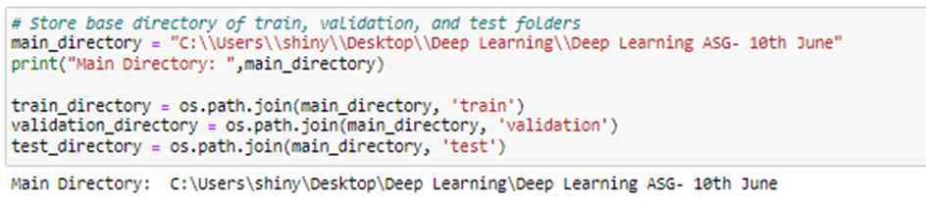
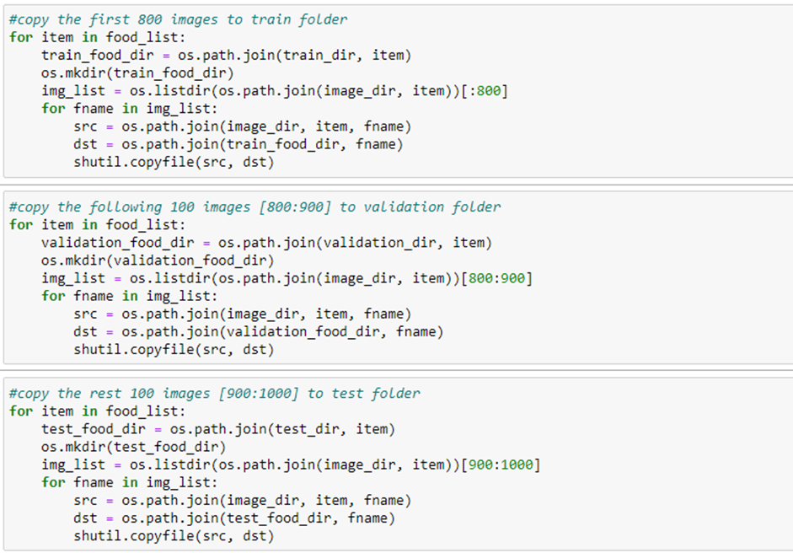
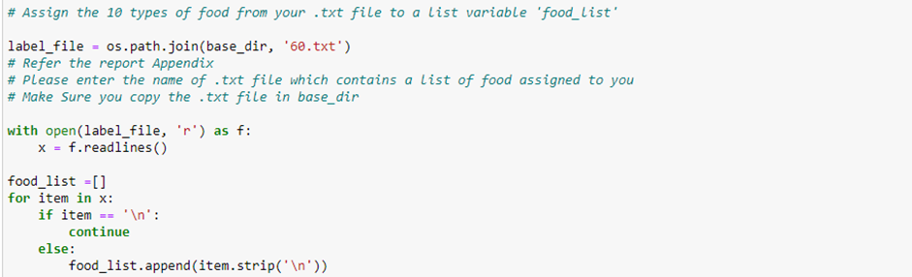
Data Loading Overview
Obtaining the path of train, validation, and test dataset
Splitting the Training, Validation, and Test of Each Food Image in the ratio of 800:100:100
Reading Text File of Food Items and storing them in food_list
Notes:
[Speaker: Seo Shin Youn]
In the Data Loading stage, our objective would be to extract the 10 food items that we have been assigned with into the train, validation, and test datasets which follows the split ratio we have chosen of 800:100:100 respectively. Hence, with the train, validation, and test datasets defined in our local system, we can obtain the path for each of the dataset by using the OS module as observed from Figure 1. Thus, by using the os.path.join() method which concatenates the respective name of the dataset, it would allow us to obtain the file path of the training directory, validation directory, and test directory. To then store the various food items from the text file we have been assigned with to a list, we could make use of the os.path.join() method as well to obtain the text file path located in our base directory. Hence, by reading the various food items in the text file, we can then loop through the list of items by subsequently storing them in ‘food_list’ as observed from Figure 2. After which, given that we have previously mentioned that we would like to split the training, validation, and testing dataset according to the ratio of 800:100:100, the code as observed from Figure 3 would do the following by looping through each of the food item for the respective directories and copying 800 of each food item image into the training directory, 100 of each food item image into the validation directory, with 100 of each food item image into the testing directory out of the 1000 food image available for each food item.

Slide 9
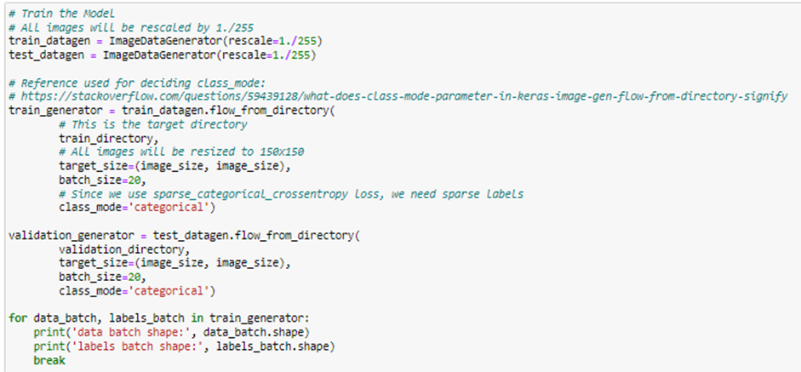
Data Preprocessing Overview
From ImageDataGenerator:
Decode JPEG Content to RGB Grids of Pixels
Rescale NumPy Array between 0 to 1
Standardize Image Size as 150x150
Batch Size of 10 or 20 (Dependent on Model)
Class_mode of ‘Categorical’
An Example of Image Pre-Processing done for an unoptimized Model Trained From Scratch
Notes:
[Speaker: Seo Shin Youn]
As observed from Figure 4 to perform data preprocessing, we could import the ImageDataGenerator class from the tensorflow.keras.preprocessing.image library which would allow us to transform the images into a NumPy array by decoding the JPEG content to RGB grids of pixels ranging from 0 to 255. Additionally, although we would use different arguments in the ImageDataGenerator class initialized across different models, the models would all have a common argument of rescale = 1./255 which would scale the NumPy array to value ranging from 0 to 1. For our training and validation dataset, given that convolutional neural networks would require images of the same size as input, we will be using 150x150 as the default resolution for all our images in the training and validation dataset. This ultimately prevents shrinking which may cause deformation of features and patterns inside the image. Additionally, rather than having the entire sample of training and validation data to be propagated through the network at one time, we could utilize batch_size to control the accuracy of estimate of the error gradient when training neural network. In the above example, we had set the batch_size to 20 which indicates that 20 samples would be propagated through the network once at a time. Additionally, for our class_mode, given that we have 10 different food items that are mutually exclusive, the ‘categorical’ class_mode would be suitable for the categorical cross entropy loss.

Slide 10
Multi-Class Image Classification Models
03
Building, Optimizing, and Analyzing our chosen CNN models trained from scratch and pre-trained models
Notes:
[Speaker: Seo Shin Youn]

Slide 11
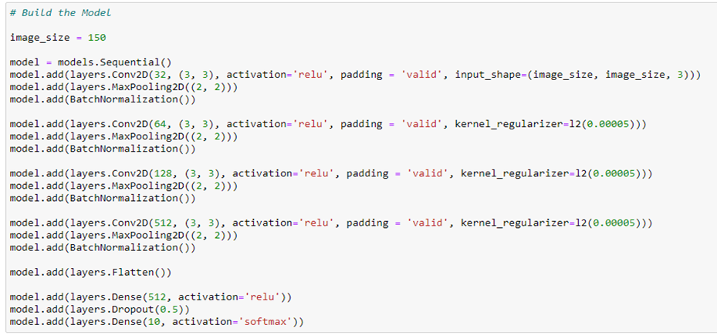
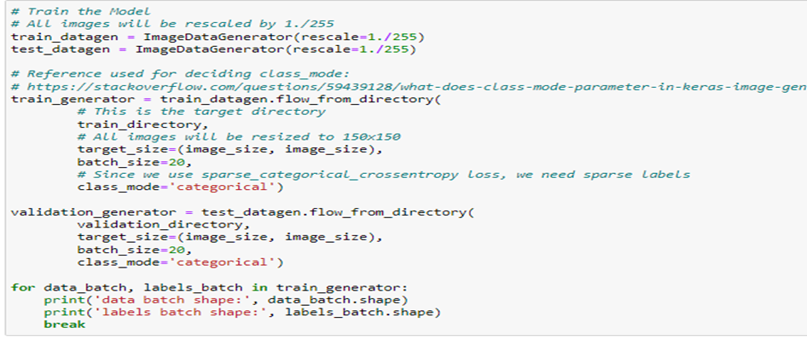
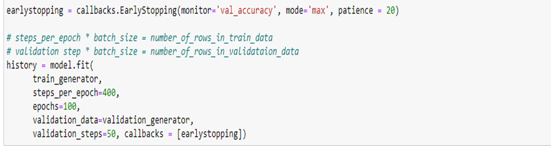
1A - CNN Model Built From Scratch without Data Augmentation
Model Compilation with categorical cross entropy as loss function
Stack of alternated Conv2D Layers, Max Pooling Layers, Batch Normalization Layers, 2 Fully Connected Dense Layers
Data Preprocessing
(Resizing and Scaling Image, Class_mode as ‘categorical’)
Early Stopping to prevent CNN model from running after maximum validation accuracy does not increase any further after 20 epochs
Notes:
[Speaker: Seo Shin Youn]
As observed from Figure 5, we could observe that our convolutional neural network model trained from scratch consist of a stack of alternated Conv2D layers using Rectified Linear Unit activation function, MaxPooling2D layers, alongside Batch Normalization layers. Additionally, as observed from the 2 Dense layers, given that we intend to classify 10 different types of food items, we would utilize 10 units as the end layer with a SoftMax activation function which would assist in assigning decimal probabilities to each class in a multi-class problem. Hence, the reason why we had utilized Batch Normalization layers would be because it would significantly increase the learning rate which further increases the speed at which the network trains. Thus, this would reduce the likelihood of overfitting. Furthermore, by applying layer weight regularization (i.e., kernel_regularizer = l2(0.00005)) on the second Conv2D layers onwards, this would apply penalties on layer parameters which ultimately reduces chances of overfitting. As illustrated from Figure 6, which shows the compilation of our model, we could observe that in order to optimize the weights, we had utilized an optimizer value of ‘Adam’ – a variation to the classical stochastic gradient descent, and to find the deviation in the learning process, we had utilized a loss function of ‘categorical_crossentropy’ given that it is suited for multi-class classification task whereby a sample can only belong to one out of the ten possible food items. Additionally, we had utilized a metrics of value ‘accuracy’ which would calculate how often predictions are equivalent to the labels. To prepare our food image dataset for training, we could observe Figure 7 which illustrates the data preprocessing procedures taken for our following model. Hence, for this particular model, we had firstly transformed the images into NumPy Array using the ImageDataGenerator class alongside rescaling the array values between 0 to 1 which allows for quicker computation and higher accuracy as part of the training and validation dataset. Additionally, to achieve quicker computation, we had resized the images to 150x150 which prevents issues such as shrinkage which may lead to loss of feature patterns. As for this particular model, we would be utilizing a batch size of 20 alongside a class_mode of ‘categorical’ given that we have utilized ‘categorical_crossentropy’ as our loss function. Hence, to understand how well the following model that we have created generalizes similar data to that on which it was trained, we would use the fit function as observed from Figure 8 which utilizes a steps_per_epoch of 400, an iteration of 100 (i.e. epochs = 100), and a validation_steps of 50. Hence, the steps_per_epoch value used could be derived from the following formula of steps per epoch = No. of samples in training set / batch size while the value used for validation steps (i.e., 50) could be derived from the following formula of validation steps = No. of samples in validation set / batch size. Additionally, to prevent the model from going through iterations that are meaningless, we had utilized early stopping which prevents the model from running further epochs once the maximum validation accuracy does not increase any further after 20 epochs or more(i.e., patience = 20).

Slide 12
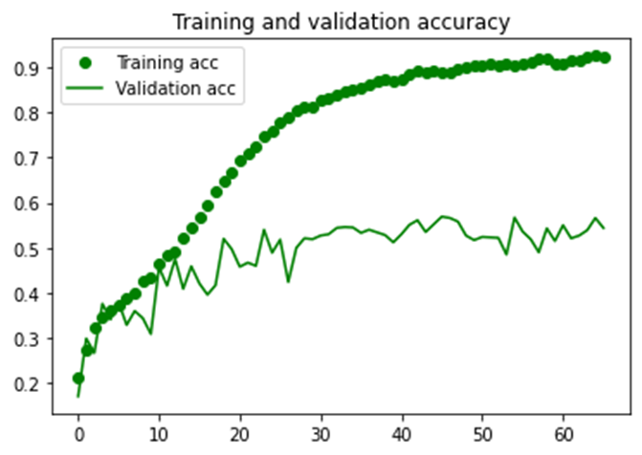
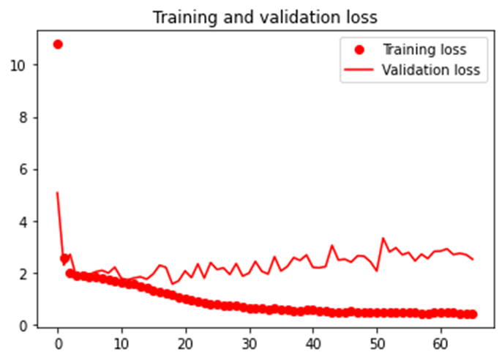
1A - CNN Model Built From Scratch without Data Augmentation
Early Stoppage of 66/100 Epochs with signs of Model Overfitting
Training Accuracy - 92.40%
Validation Accuracy - 52.40%
Training Loss - 0.4194
Validation Loss - 2.5086
Notes:
[Speaker: Seo Shin Youn]
From the above graphs which illustrates the training and validation accuracy and loss, we could observe that overfitting has occurred such that while the training accuracy has increased linearly to around 94% accuracy at 85 epochs, the validation accuracy hovers around 55% accuracy. Likewise, by observing the training and validation loss, we could observe that while our validation loss reaches its minimum of around less than 10 epochs, our training loss has decreased consistently even as the rate of change may not be as significant. Additionally, from Figure 10, we could observe that the model has stopped training at 66 epochs although we have set an epoch to 100 as the early stopping callbacks had stopped training given that the maximum validation accuracy had not increase any further for 20 epochs.

Slide 13
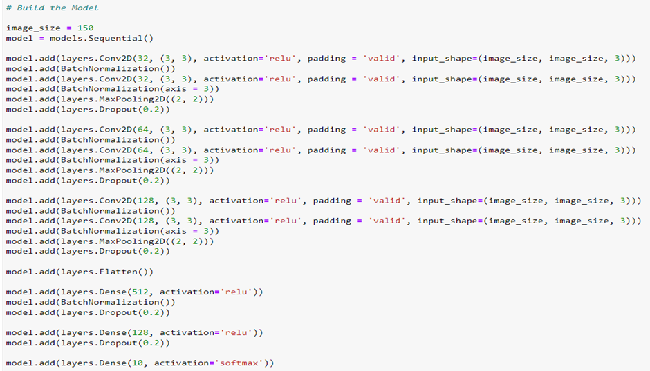
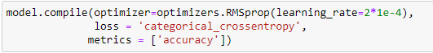
1B - CNN Model Built From Scratch with Data Augmentation
Model Compilation with change in learning rate from ‘Adam’ to RMSprop(learning_rate = 2*1e-4)
Introduction of Dropout layers and addition of more Batch Normalization layers to reduce overfitting. Addition of Conv2D layers to increase model training and testing accuracy
Notes:
[Speaker: Seo Shin Youn]
Our main goal for Model 1B would thus be to minimize the overfitting that has occurred in Model 1A while also increasing the validation accuracy of the following mode. To thus reduce overfitting, we could make use of regularization techniques including more dropout layers throughout the sequential model alongside a larger number of batch normalization layers which would assist in reducing overfitting. Likewise, by using more Conv2D layers, this would allow our model to pick up more features which would lead to a higher validation accuracy. As observed from Figure 11, our optimized convolutional neural network model trained from scratch consists of a stack of alternated Conv2D layers and Batch Normalization layers twice before MaxPooling2D layers and a Dropout layer of value 0.2 is being utilized. Additionally, as observed from the 3 Dense layers, given that we intend to classify 10 different types of food items, we would utilize 10 units as the end layer with a SoftMax activation function which would assist in assigning decimal probabilities to each class in a multi-class problem. Hence, the reason why we had utilized Batch Normalization layers would be because it would significantly increase the learning rate which further increases the speed at which the network trains. Thus, this would reduce the likelihood of overfitting. Furthermore, by applying a Dropout layer after every MaxPooling2D layer, it would assist in randomly setting 20% of input unit to 0 with a frequency of rate at each step during training time, which prevents overfitting. Additionally, as observed from Figure 12, although most our variables remain constant, the only argument we had changed would be to use a learning rate of 2*1e-4 which is much faster than the ‘Adam’ optimizer we had previously utilized. Hence, it would allow our model to learn faster which prevents overfitting.

Slide 14
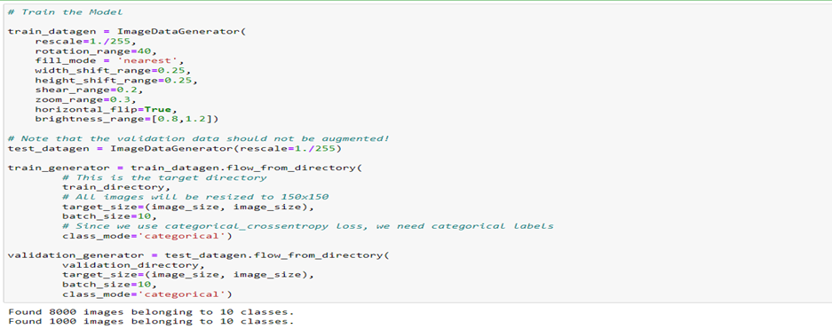
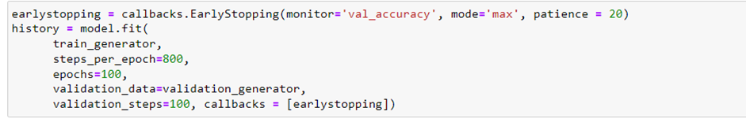
1B - CNN Model Built From Scratch with Data Augmentation
Data Preprocessing
(Resizing and Scaling Image, Class_mode as ‘categorical’)
Data Augmentation
(Rotate Image, Fill empty spaces with nearest values, shift image vertically & horizontally, change dimensionality, magnify image, flip image horizontally, control brightness of image)
Early Stopping to prevent CNN model from running after maximum validation accuracy does not increase any further after 20 epochs
Notes:
[Speaker: Seo Shin Youn]
Furthermore, to ensure that overfitting does not occur due to the lack of variety of samples, which renders our model from training unseen data, we could utilize data augmentation which seeks to generate different variations of our food dataset artificially to increase its size after every epoch. Hence, from Figure 12 which illustrates the data augmentation technique we had utilized, we had firstly rescaled the image to a value between 0 and 1 as usual alongside setting a rotation of 40 which randomly rotates the picture by 40 degrees. Furthermore, given that rotated images may lose some of its features, we could replace the missing features using the fill_mode argument of value ‘nearest’ which copies over the nearest values possible. Additionally, by setting a value of 0.25 to both width and height shift, it would move the object image by 20% horizontally and vertically. Other arguments we had utilized would also contain shear range, we seek to rectify the perception angles, horizontal flip as the name suggest, alongside brightness range which control the bright of the variety of images. As for this particular model, we would be utilizing a batch size of 10 instead of 20 which would lead to higher accuracy. Hence, to understand how well the following model that we have created generalizes similar data to that on which it was trained, we would use the fit function as observed from Figure 13 which utilizes a steps_per_epoch of 800, an iteration of 100 (i.e. epochs = 100), and a validation_steps of 100. Hence, the steps_per_epoch value used could be derived from the following formula of steps per epoch = No. of samples in training set / batch size while the value used for validation steps (i.e., 100) could be derived from the following formula of validation steps = No. of samples in validation set / batch size. Additionally, to prevent the model from going through iterations that are meaningless, we had utilized early stopping which prevents the model from running further epochs once the maximum validation accuracy does not increase any further after 20 epochs or more (i.e., patience = 20).

Slide 15
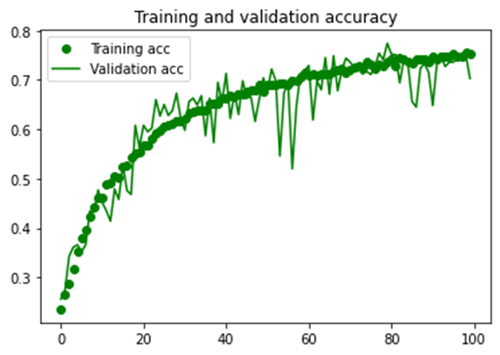
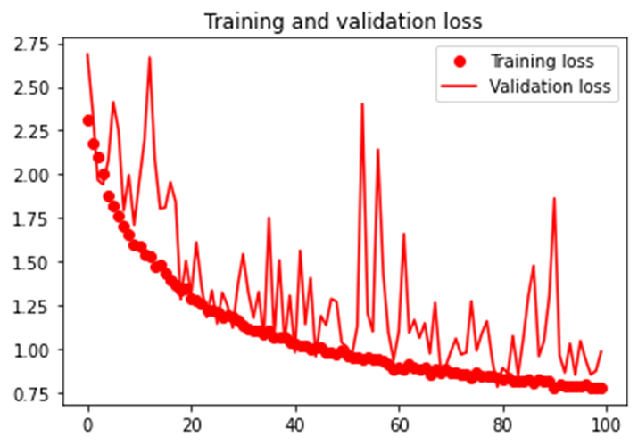
1B - CNN Model Built From Scratch with Data Augmentation
100/100 Epochs ran with no signs of Model Overfitting/Underfitting
Training Accuracy - 75.35%
Validation Accuracy - 70.30%
Training Loss - 0.7771
Validation Loss - 0.9833
Notes:
[Speaker: Seo Shin Youn]
As a result of applying data augmentation techniques alongside using a larger number of dropout layers and batch normalization layers, it could be observed from Figure 14, which illustrates the training and validation accuracy and loss that the model is no longer overfitting. This is evident from the fact that both training and validation accuracy and loss are rather close to one another which shows that there is not much deviation between the accuracy and loss of training and validation dataset. Furthermore, as a result of using more Conv2D layers alongside a smaller batch size, it could be observed that although our training accuracy has decreased from 94% to approximately 75.35%, we have managed to increase our validation accuracy from 52.40% to over 70% as well. Lastly, from Figure 14, we could observe that although we have set an epoch to 100 the early stopping callbacks had not been triggered.

Slide 16
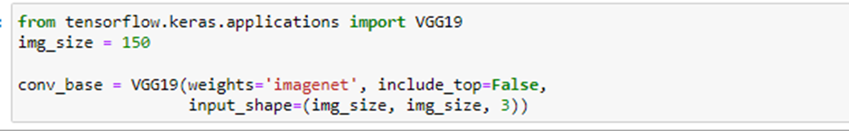
2A - Data Augmented VGG19 Model without Fine-Tuning
What is VGG19?
The VGG19 model has 19 trainable weights (16 Convolutional + 3 Fully Connected layers)
The base, VGG19 will be extended by our own Fully Connected Dense Layer to classify the
10 different types of food
Instantiation of VGG19 Model
Would utilize our own densely connected classifier of 10 food items instead of the 1000 classes from ImageNet
Notes:
[Speaker: Seo Shin Youn]
Of the three pretrained model that will be covered in this report, the first pre-trained convolutional neural network that we would be looking at involves the VGG19 model, where the number 19 stands for the number of layers with trainable weights (i.e., 16 Convolutional layers and 3 Fully Connected layers). Hence, as part of model 2A, we will be performing feature extraction with data augmentation by extending the conv_base model through adding dense layers and running the whole thing end-to-end on input data. Thus, although the model would be more computationally more expensive to run, it would allow us to leverage data augmentation given that the input images would go through the convolutional base every time it is seen by the VGG19 model. As illustrated from Figure 15, to instantiate the VGG19 model, we could firstly import the model through the tensorflow.keras.applications library whereby we can declare the VGG19 class of weights value ‘imagenet’, setting a value of False to input_top given that we intend to use our own densely-connected classifier of 10 food classes instead of the 1000 classes from ImageNet, as well as configuring the input shape to 150x150 which represents the shape of the image tensors that will be fed into the network.

Slide 17
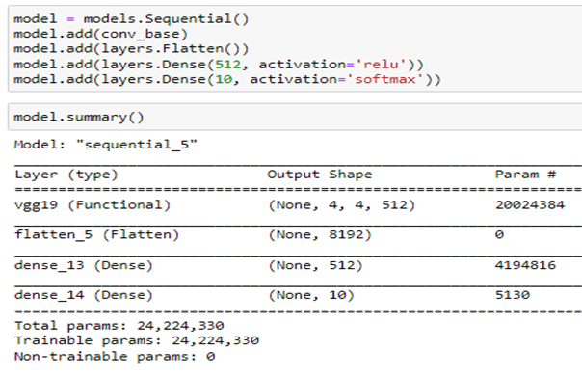
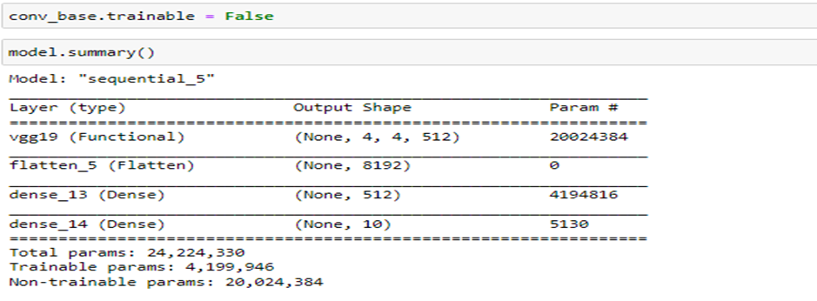
2A - Data Augmented VGG19 Model without Fine-Tuning
Freezing - Prevent weights of the Convolutional Base from being updated to ensure that the representations do not get modified during training
Only 4+ Million Parameters are trainable (Extended Layers)
Extending the VGG19 Model with a flatten layer and 2 dense layers
All 24+ Million Parameters are trainable
Notes:
[Speaker: Seo Shin Youn]
To add our own densely connected classifier, we could utilize the VGG19 model the same way a sequential model is being built. Hence, on top of convolutional blocks of the VGG19 model, we will be adding a flatten layer which flattens the multi-dimensional input tensors into a single dimension before feeding it into the dense layers which has a unit of 10 to classify the 10 different food images. Furthermore, as illustrated from the model summary in Figure 16, we could observe that the convolutional base of VGG19 has over 20 million parameters on top of the 4 million parameters of the classifier. Hence, to ensure that the weights of the convolutional base do not get updated, we can perform freezing so that the representations do not get modified during training. Otherwise, given that we have not trained our classifier, the error signal that is propagated through the network would be too large.
Hence, to freeze the convolutional base of VGG19, we could simply do so by setting its trainable attribute to False as illustrated from Figure 17. Thus, as illustrated from the model summary before and after freezing, we could observe that the number of trainable parameters has decreased from over 24 million parameters to around 4 million trainable parameters.

Slide 18
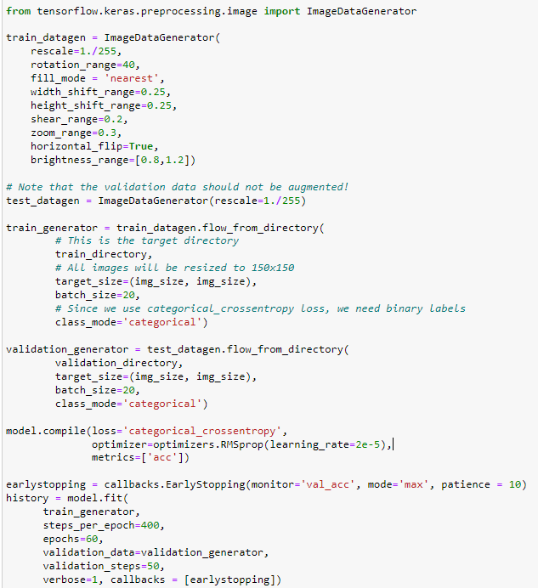
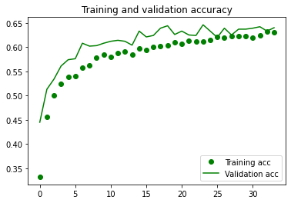
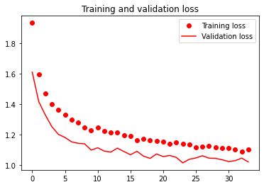
2A - Data Augmented VGG19 Model without Fine-Tuning
Early Stoppage of 34/60 Epochs with minor signs of Model underfitting
Data Augmentation
Training Accuracy - 63.06%
Validation Accuracy - 64.00%
Training Loss - 1.1021
Validation Loss - 1.0224
Model Compilation
Model Fitting + Early Stopping
Notes:
[Speaker: Seo Shin Youn]
Thereafter, to ensure that overfitting does not occur due to the lack of variety of samples, which renders our model from training unseen data, we could utilize data augmentation on only our training data which seeks to generate different variations of our food dataset artificially to increase its size after every epoch. Hence, from Figure 18 which illustrates the data augmentation technique we had utilized, we had firstly rescaled the image to a value between 0 and 1 as usual alongside setting a rotation of 40 which randomly rotates the picture by 40 degrees. Furthermore, given that rotated images may lose some of its features, we could replace the missing features using the fill_mode argument of value ‘nearest’ which copies over the nearest values possible. Additionally, by setting a value of 0.25 to both width and height shift, it would move the object image by 20% horizontally and vertically. Other arguments we had utilized would also contain shear range, we seek to rectify the perception angles, horizontal flip as the name suggest, alongside brightness range which control the bright of the variety of images.As for this particular VGG19 model, we would be utilizing a batch size of 20 alongside a class_mode of ‘categorical’ given that we have utilized ‘categorical_crossentropy’ as our loss function.Hence, to understand how well the following model that we have created generalizes similar data to that on which it was trained, we would use the fit function as observed from Figure 18 which utilizes a steps_per_epoch of 400, an iteration of 60 (i.e. epochs = 60), and a validation_steps of 50. Hence, the steps_per_epoch value used could be derived from the following formula of steps per epoch = No. of samples in training set / batch size while the value used for validation steps (i.e., 50) could be derived from the following formula of validation steps = No. of samples in validation set / batch size. Additionally, to prevent the model from going through iterations that are meaningless, we had utilized early stopping which prevents the model from running further epochs once the maximum validation accuracy does not increase any further after 10 epochs or more (i.e., patience = 10).
Thus, by observing the training and validation accuracy and loss as illustrated from Figure 19, we could observe that there are no signs of overfitting given that both training and validation accuracy has similar level of accuracy which may be attributed to the data augmentation we had performed. In fact, from 0 to 50 epochs, we could observe that the model had been underfitting as observed from the higher validation accuracy compared to training accuracy before being resolved afterwards. Hence, as observed at the end of 60 epochs, we managed to receive a training accuracy of 64.33% and a validation accuracy of 64.80%. While on the other hand, by the end of 60 epochs, the model had training loss of 1.03 and a validation loss of 1.03 as well.

Slide 19
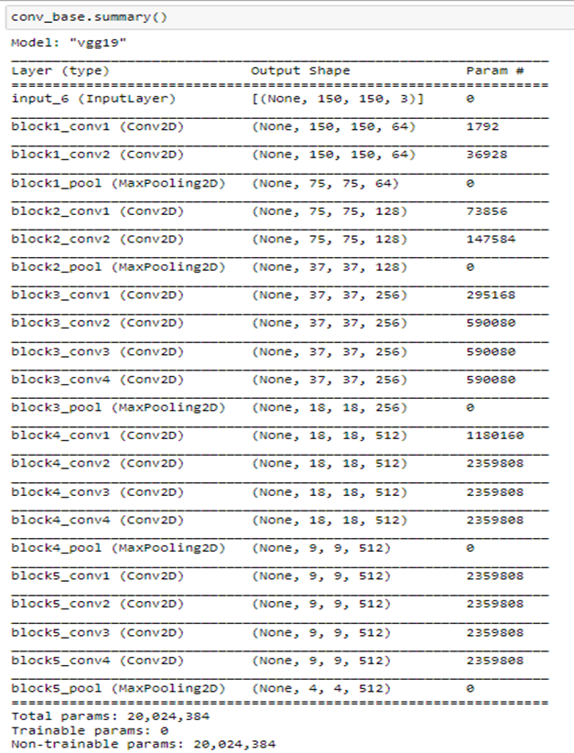
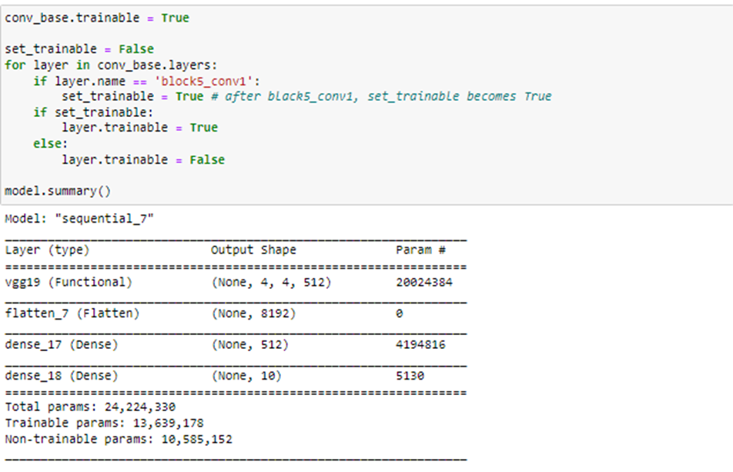
2B - Data Augmented VGG19 Model with Fine-Tuning
Unfreezing Convolutional Base Layers
0 Trainable Parameters currently (All frozen)
Only Fine-Tune Layers Higher Up would be unfrozen (Highlighted in red) as they are able to encode more specialized features → Higher accuracy
All layers beyond block5_conv1 would be unfrozen while layers before it remain untrainable
Notes:
[Speaker: Seo Shin Youn]
Given that there are no issues in Model 2A regarding overfitting or underfitting our objective for model 2B would thus be to mainly increase our overfall training and validation accuracy given that the performance of Model 2A was relatively low (60+% for both training and validation accuracy) compared to the model we had built from scratch in Model 1A and 1B. Hence, given that we have already froze our VGG19 convolutional base and have trained our fully connected classifier as evident Model 2A, the next step would be to unfreeze some layers at the top of the VGG19 model so that we would be able to fine-tune the more specialized features rather than fine-tuning the entire convolutional base which may lead to overfitting and wasting computing resources to train generical features. Thus, this would lead to an overall increase in both training and validation accuracy. Looking back at our VGG19 convolutional base, we could observe that the VGG19 base has a total of 0 trainable parameter given that we have previously frozen all of the convolutional layers in Model 2A. Thus, as we would only want to fine-tune layers higher up given that they are able to encode more specialized features, we will set block5_conv1 layer onwards to be trainable while all previous layers before block5_conv1 would remain frozen. Thus, by setting layers beyond block5_conv1 to be trainable (unfrozen) while the layers before that remain frozen, we could observe that we have an increase in trainable parameters from over 4 million trainable parameters to over 13 million trainable parameters.

Slide 20
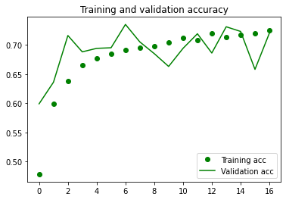
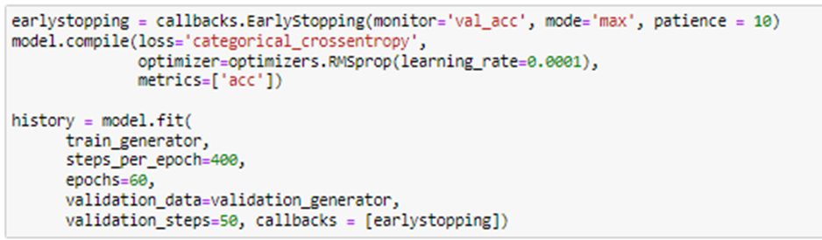
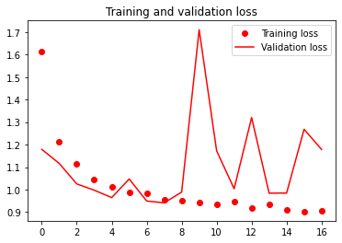
2B - Data Augmented VGG19 Model with Fine-Tuning
Early Stoppage of 17/60 Epochs with no signs of overfitting/underfitting
Training Accuracy - 72.48%
Validation Accuracy - 72.00%
Early Stopping to prevent CNN model from running after maximum validation accuracy does not increase any further after 10 epochs
Training Loss - 0.9067
Validation Loss - 1.1785
Notes:
[Speaker: Seo Shin Youn]
Hence, to understand how well the following model that we have created generalizes similar data to that on which it was trained, we would use the fit function as observed from Figure 22 which utilizes a steps_per_epoch of 400, an iteration of 60 (i.e. epochs = 60), and a validation_steps of 50. Hence, the steps_per_epoch value used could be derived from the following formula of steps per epoch = No. of samples in training set / batch size while the value used for validation steps (i.e., 50) could be derived from the following formula of validation steps = No. of samples in validation set / batch size. Additionally, to prevent the model from going through iterations that are meaningless, we had utilized early stopping which prevents the model from running further epochs once the maximum validation accuracy does not increase any further after 10 epochs or more (i.e., patience = 10). Thus, by observing the training and validation accuracy and loss as illustrated from Figure 23, we could observe that there are no signs of overfitting or underfitting given that both training and validation accuracy has similar level of accuracy which may be attributed to the fine-tuning that we had performed. In fact, from 0 to 6 epochs, although we could observe that the model had been underfitting as observed from the higher validation accuracy compared to training accuracy, it has been resolved afterwards. Hence, as observed at the end of 17 epochs, we managed to receive a training accuracy of 72.48% and a validation accuracy of 72.00%. While on the other hand, at the end of 17 epochs, the model had training loss of 0.9067 and a validation loss of 1.1785 as well.

Slide 21
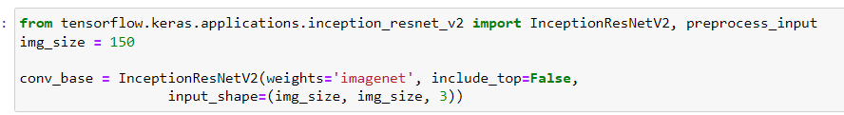
3A - Data Augmented Inception ResNet V2 Model without Fine-Tuning
What is Inception ResNet V2?
The Inception ResNet V2 network is 164 layers deep and has been trained on a million images from the ImageNet database
The base, Inception ResNet V2 will be extended by our own Fully Connected Dense Layer to classify the 10 different types of food
Instantiation of Inception ResNet V2 Model
Would utilize our own densely connected classifier of 10 food items instead of the 1000 classes from ImageNet
Notes:
[Speaker: Seo Shin Youn]
The next pre-trained convolutional neural network that we will be looking at involves InceptionResNetV2, which is a convolutional neural network that is trained on more than a million images from the ImageNet database. Additionally, the network is 164 layers deep which is far more complex than the VGG19 model previously discussed given that it has a total of over 54 million trainable parameters compared to the VGG19 model which had a total of over 24 million trainable parameters. Hence, as part of model 3A, we will be performing feature extraction with data augmentation by extending the conv_base model through adding dense layers and running the whole thing end-to-end on input data. Thus, although the model would be more computationally more expensive to run, it would allow us to leverage data augmentation given that the input images would go through the convolutional base every time it is seen by the InceptionResNetV2 model. As illustrated from Figure 24, to instantiate the InceptionResNetV2 model, we could firstly import the model through the tensorflow.keras.applications.inception_resnet_v2 library whereby we can declare the InceptionResNetV2 class of weights value ‘imagenet’, setting a value of False to input_top given that we intend to use our own densely-connected classifier of 10 food classes instead of the 1000 classes from ImageNet, as well as configuring the input shape to 150x150 which represents the shape of the image tensors that will be fed into the network.

Slide 22
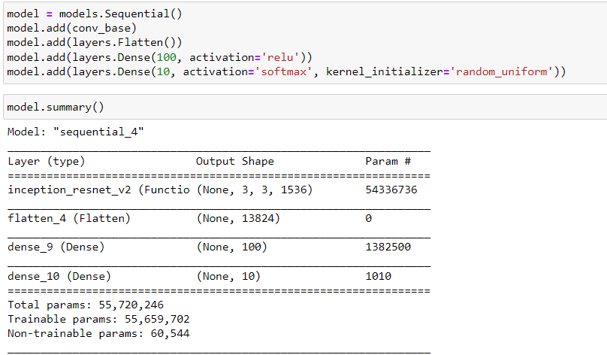
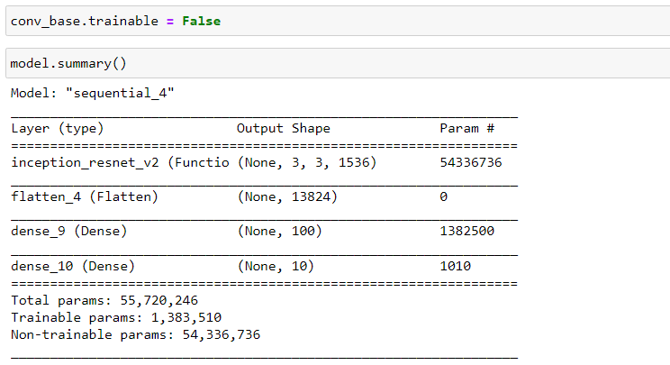
3A - Data Augmented Inception ResNet V2 Model without Fine-Tuning
Extending the Inception ResNet V2 Model with a flatten layer and 2 dense layers
All 55+ Million Parameters are trainable
Freezing - Prevent weights of the Convolutional Base from being updated to ensure that the representations do not get modified during training
Only 1.3+ Million Parameters are trainable (Extended Layers)
Notes:
[Speaker: Seo Shin Youn]
To add our own densely connected classifier, we could utilize the InceptionResNetV2 model the same way a sequential model is being built. Hence, on top of convolutional blocks of the InceptionResNetV2 model, we will be adding a flatten layer which flattens the multi-dimensional input tensors into a single dimension before feeding it into the dense layers which has a unit of 10 to classify the 10 different food images. Furthermore, as illustrated from the model summary in Figure 25, we could observe that the convolutional base of InceptionResNetV2 has over 54 million parameters on top of the 1.3 million parameters of the classifier. Hence, to ensure that the weights of the convolutional base do not get updated, we can perform freezing so that the representations do not get modified during training. Otherwise, given that we have not trained our classifier, the error signal that is propagated through the network would be too large.
Hence, to freeze the convolutional base of InceptionResNetV2, we could simply do so by setting its trainable attribute to False as illustrated from Figure 26. Thus, as illustrated from the model summary before and after freezing, we could observe that the number of trainable parameters has decreased from over 55 million parameters to around 1.3 million trainable parameters.

Slide 23
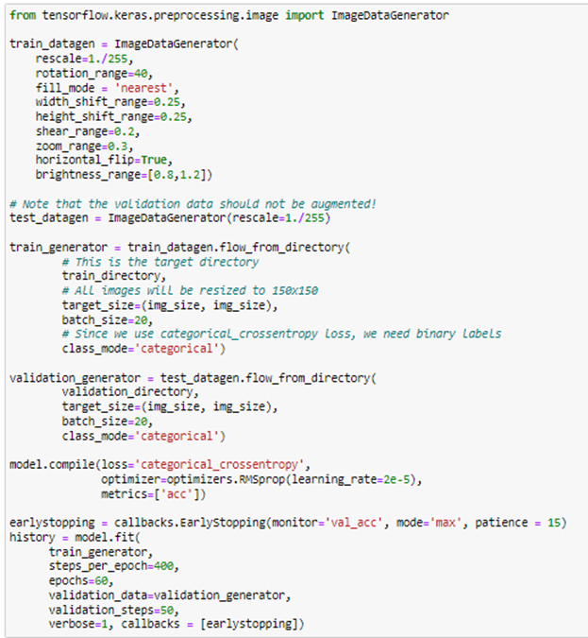
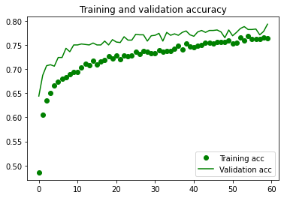
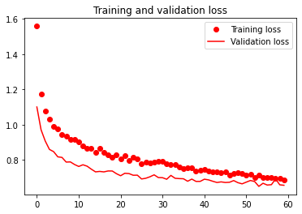
3A - Data Augmented Inception ResNet V2 Model without Fine-Tuning
60/60 Epochs Fully Runned with minor signs of Model underfitting
Data Augmentation
Training Accuracy - 76.35%
Validation Accuracy - 79.30%
Training Loss - 0.6876
Validation Loss - 0.7930
Model Compilation
Model Fitting + Early Stopping
Notes:
[Speaker: Seo Shin Youn]
Thereafter, to ensure that overfitting does not occur due to the lack of variety of samples, which renders our model from training unseen data, we could utilize data augmentation on only our training data which seeks to generate different variations of our food dataset artificially to increase its size after every epoch. Hence, from Figure 27 which illustrates the data augmentation technique we had utilized, we had firstly rescaled the image to a value between 0 and 1 as usual alongside setting a rotation of 40 which randomly rotates the picture by 40 degrees. Furthermore, given that rotated images may lose some of its features, we could replace the missing features using the fill_mode argument of value ‘nearest’ which copies over the nearest values possible. Additionally, by setting a value of 0.25 to both width and height shift, it would move the object image by 25% horizontally and vertically. Other arguments we had utilized would also contain shear range, we seek to rectify the perception angles, horizontal flip as the name suggest, alongside brightness range which control the bright of the variety of images. Moreover, as for this particular InceptionResNetV2model, we would be utilizing a batch size of 20 alongside a class_mode of ‘categorical’ given that we have utilized ‘categorical_crossentropy’ as our loss function. Hence, to understand how well the following model that we have created generalizes similar data to that on which it was trained, we would use the fit function as observed from Figure 27 which utilizes a steps_per_epoch of 400, an iteration of 60 (i.e. epochs = 60), and a validation_steps of 50. Hence, the steps_per_epoch value used could be derived from the following formula of steps per epoch = No. of samples in training set / batch size while the value used for validation steps (i.e., 50) could be derived from the following formula of validation steps = No. of samples in validation set / batch size. Additionally, to prevent the model from going through iterations that are meaningless, we had utilized early stopping which prevents the model from running further epochs once the maximum validation accuracy does not increase any further after 15 epochs or more (i.e., patience = 15).
Thus, by observing the training and validation accuracy and loss as illustrated from Figure 27, we could observe that although there are no signs of overfitting, we could observe that the InceptionResNetV2 model is slightly underfitting as observed from the marginally higher validation accuracy compared to the training accuracy. Hence, at the end of 60 epochs, we could observe that the model is able to produce a training accuracy of 76.35% and a validation accuracy of 79.30%. On the other hand, by the end of 60 epochs, the model had a training loss of 0.6876 and a validation loss of 0.6560 as well.

Slide 24
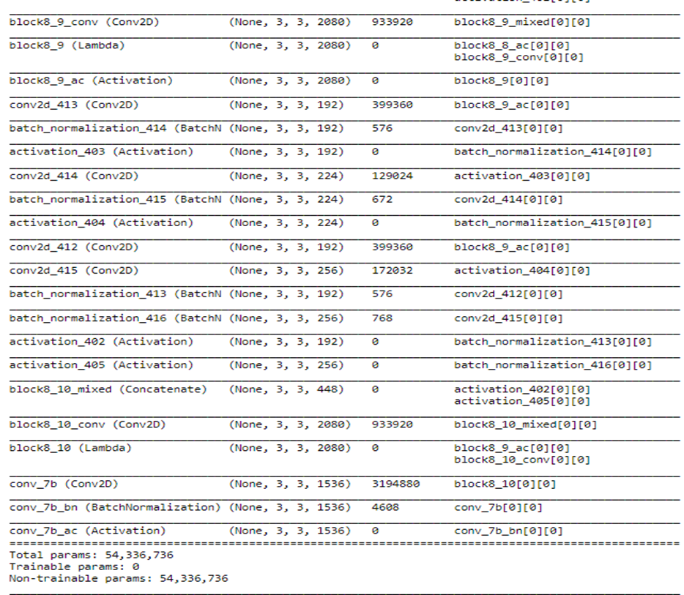
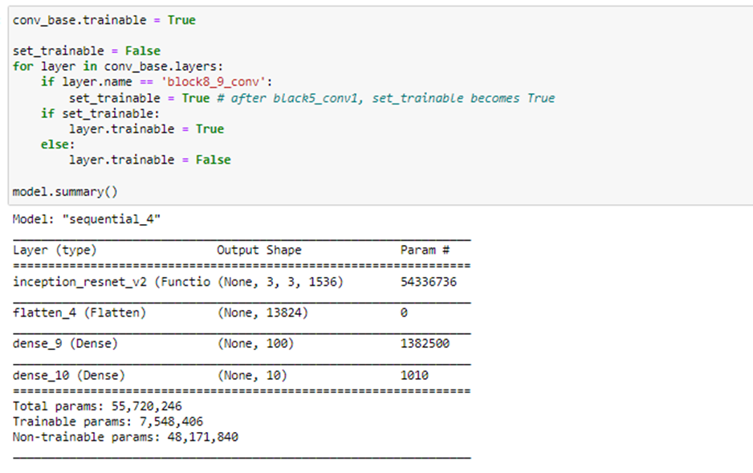
3B - Data Augmented Inception ResNet V2 Model with Fine-Tuning
Unfreezing Convolutional Base Layers
0 Trainable Parameters currently (All frozen)
Only Fine-Tune Layers Higher Up would be unfrozen (Highlighted in red) as they are able to encode more specialized features → Higher accuracy
All layers beyond block8_9_conv would be unfrozen while layers before it remain untrainable
Notes:
[Speaker: Seo Shin Youn]
Given that the Model 3A is only marginally underfitting, our objective for model 3B would thus be to mainly increase our overall training and validation accuracy given that the performance of Model 3A was relatively average (70+% for both training and validation accuracy) compared to the model we had built from scratch in Model 1A and 1B. Hence, given that we have already frozen our InceptionResNetV2 convolutional base and have trained our fully connected classifier as evident Model 3A, the next step would be to unfreeze some layers at the top of the InceptionResNetV2 model so that we would be able to fine-tune the more specialized features rather than fine-tuning the entire convolutional base which may lead to overfitting and wasting computing resources to train generical features. Thus, this would lead to an overall increase in both training and validation accuracy. Looking back at our InceptionResNetV2 convolutional base, we could observe that the InceptionResNetV2 base has a total of 0 trainable parameter given that we have previously frozen all of the convolutional layers in Model 3A. Thus, as we would only want to fine-tune layers higher up given that they are able to encode more specialized features, we will set block8_9_conv layer onwards to be trainable while all previous layers before block8_9_conv would remain frozen. Thus, by setting layers beyond block8_9_conv to be trainable (unfrozen) while the layers before that remain frozen, we could observe that we have an increase in trainable parameters from over 3 million trainable parameters to over 7 million trainable parameters in the model.

Slide 25
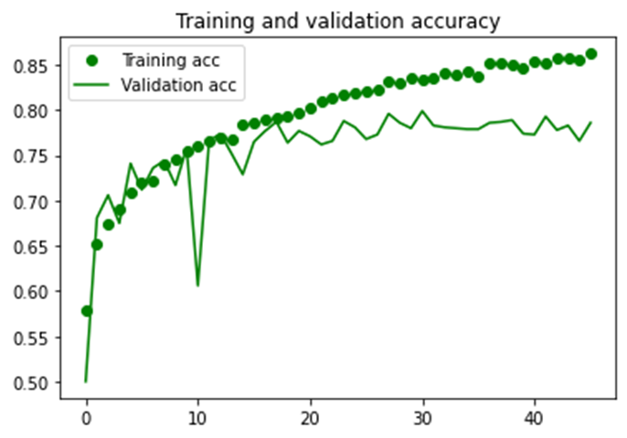
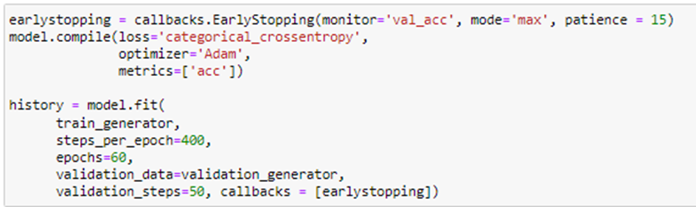
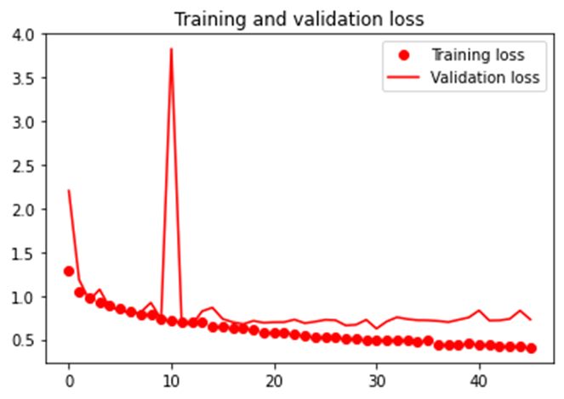
3B - Data Augmented Inception ResNet V2 Model with Fine-Tuning
Early Stoppage of 46/60 Epochs with signs of overfitting
Training Accuracy - 86.26%
Validation Accuracy - 78.60%
Early Stopping to prevent CNN model from running after maximum validation accuracy does not increase any further after 15 epochs
Training Loss - 0.4075
Validation Loss - 0.7280
Notes:
[Speaker: Seo Shin Youn]
Thus, by observing the training and validation accuracy and loss as illustrated from Figure 31, we could observe that although there are no signs of overfitting or underfitting in the first 18 epochs, we could observe that the model has started to overfit afterwards as observe from the increasing deviation between the training and validation accuracy. Additionally, by observing the Training and Validation Loss from Figure 31, we could likewise observe that the model if starting to overfit at around 18 epochs as observed from the increasing deviation between the training and validation loss.
Hence, as observed at the end of 46 out of the 60 epochs to be run due to early stoppage, we managed to receive a training accuracy of 86.26% and a validation accuracy of 78.60%. While on the other hand, at the end of 46 out of the 60 epochs, the model had training loss of 0.4075 and a validation loss of 0.7280 as well.

Slide 26
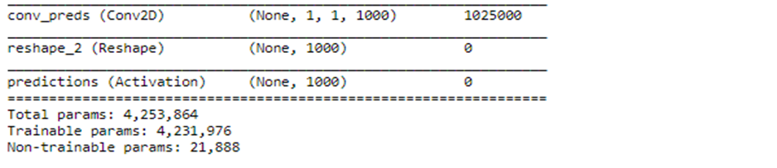
4A - Fine-Tuned MobileNet Model without Data Augmentation
What is MobileNet?
MobileNet is a lightweight CNN model designed for embedded vision & mobile applications
Will be performing Fine-Tuning Instead before Data Augmentation
The base, MobileNet, will be extended by our own Fully Connected Dense Layer to classify the
10 different types of food
Relatively low number of trainable parameters for a Pre-trained model
Instantiation of MobileNet Model
Notes:
[Speaker: Seo Shin Youn]
The fourth and last convolutional neural network that we will be covering involves Mobile Net, which is a convolutional neural network designed for embedded vision and mobile applications. Hence, its unique characteristic would be that it is a lightweight deep neural network that has relatively few parameters compared to most pre-trained models while still maintaining a high classification accuracy. Unlike how we have previously built our pre-trained models, we will firstly perform fine-tuning before performing data augmentation as our optimization technique. Hence, to instantiate the Mobile Net model, we could make use of the keras.applications.mobilenet.MobileNet() and storing it under the variable mobile. Thus, by observing the model summary, we could observe that the Mobile Net Convolutional base has a total of over 4 million parameters to be trained which is significantly less than what we have observed from the VGG19 and InceptionResNetV2 convolutional base.

Slide 27
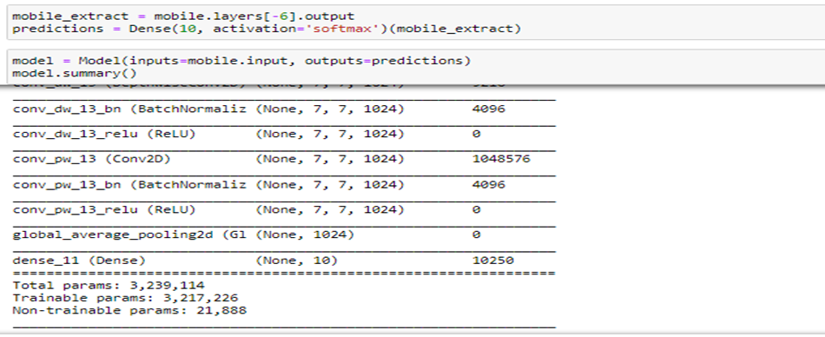
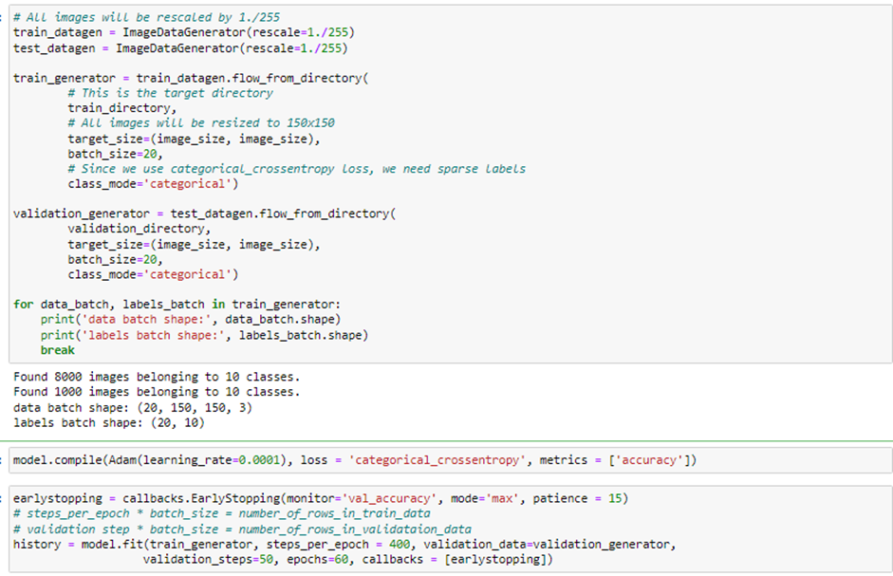
4A - Fine-Tuned MobileNet Model without Data Augmentation
Removing last six layers including predictions layer and adding our own dense layer of 10 units
Data Preprocessing
(Resizing and Scaling Image, Class_mode as ‘categorical’)
Model Compilation with categorical cross entropy as loss function
Early Stopping to prevent CNN model from running after maximum validation accuracy does not increase any further after 15 epochs
Unfreezing the last 23 layers to fine-tune their weights while extracting higher level features
Notes:
[Speaker: Seo Shin Youn]
Subsequently, given that we would like to add our own fully connected dense layer in order to classify the 10 different types of food images, we had removed the 6 last layers of the Mobile Net Model which includes the classifier for the 1000 different classes of the ImageNet database alongside adding our own output layer that contains 10 output nodes which corresponds to each of the food item. Thus, by building the model with the Keras API and printing out the model summary, we could observe that we have added in our dense layer of 10 units which represents the size of the output. Additionally, the number of parameters has decreased to 3 million parameters given that we have removed the last 6 layers as previously discussed. As we would like to keep what the original Mobile Net model has already learned from the ImageNet database, we can do so by freezing the weights of the majority of layers. However, as we would also like to fine-tune some of the layers from the Mobile Net convolutional base in order to perform transfer learning on our custom food dataset, we can do so by training only the last 23 layers of the convolutional base as observed from Figure 23. Hence, while the last 23 layers are trainable, all layers before the last 23 layers would be untrainable. Hence, to understand how well the following model that we have created generalizes similar data to that on which it was trained, we would use the fit function as observed from Figure 34 which utilizes a steps_per_epoch of 400, an iteration of 60 (i.e. epochs = 60), and a validation_steps of 50. Hence, the steps_per_epoch value used could be derived from the following formula of steps per epoch = No. of samples in training set / batch size while the value used for validation steps (i.e., 50) could be derived from the following formula of validation steps = No. of samples in validation set / batch size. Additionally, to prevent the model from going through iterations that are meaningless, we had utilized early stopping which prevents the model from running further epochs once the maximum validation accuracy does not increase any further after 10 epochs or more (i.e., patience = 15).

Slide 28
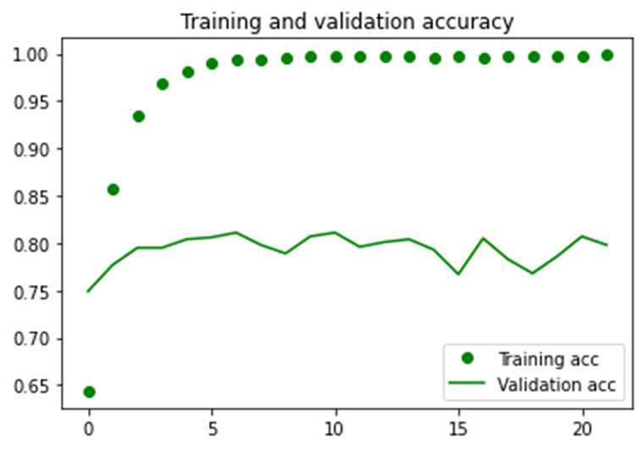
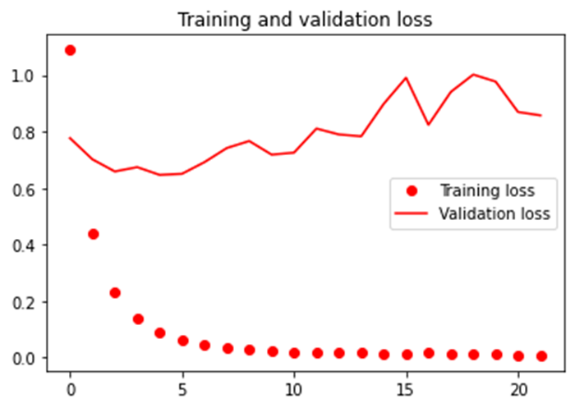
4A - Fine-Tuned MobileNet Model without Data Augmentation
Early Stoppage of 22/60 Epochs with signs of Model Overfitting
Training Accuracy - 99.89%
Validation Accuracy - 79.80%
Training Loss - 0.0086
Validation Loss - 0.8576
Notes:
[Speaker: Seo Shin Youn]
Thus, as observed from Figure 35 which shows that the model has stopped running further after 22 epochs due to the callback argument we had utilized, we could observe that the Mobile Net model has reached a training and validation accuracy of 99.89% and 79.80% respectively. Additionally, by observing the training and validation loss plot, we could observe that the model has a training loss close to 0 with an increasing validation loss of 0.8. Hence, as illustrated from Figure 35, we could observe that the model is significantly overfitted as evident of the large and increasing deviation between the training and validation accuracy. Thus, to solve this issue we could try to perform data augmentation in Model 4b so as to increase the variation of food images observed by the model each epoch which would lead to an increase in validation accuracy and reduce overfitting.

Slide 29
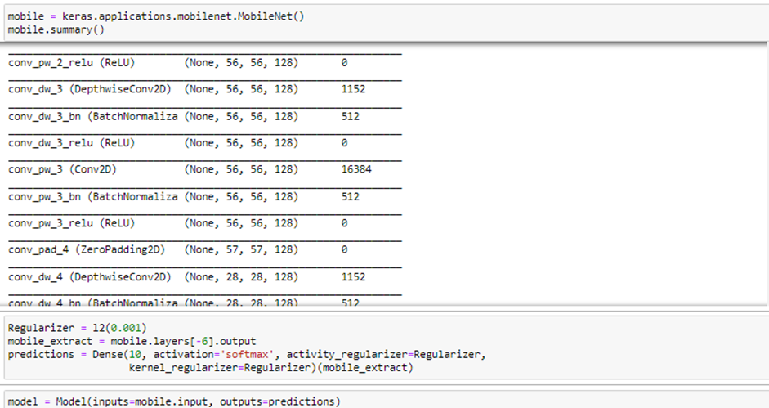
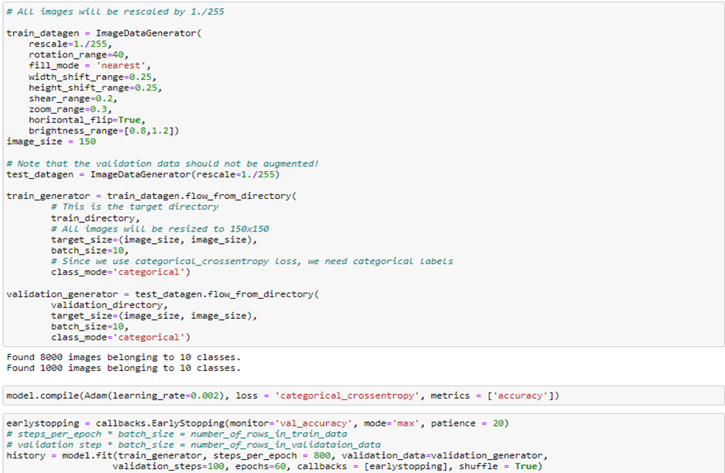
4B - Fine-Tuned MobileNet Model with Data Augmentation
Data Augmentation
Leveraging L2 Regularization Technique to reduce likelihood of overfitting
Model Compilation
Model Fitting + Early Stopping
Notes:
[Speaker: Seo Shin Youn]
Hence, given that we have previously observed from Model 4A that the ImageNet model is overfitting and has a low validation accuracy, this can be resolved by leveraging data augmentation which would increase the variation of food images observed by the model after each iteration. Additionally, we would also be performing hyperparameter tuning that may reduce the likelihood of overfitting. Similar to how we have built the ImageNet model from Model 4A, the only modification we would make would be to introduce l2 regularization technique on the fully connected Dense layer that we will be adding onto the convolutional base. Hence, by using a value of l2(0.001) on the Dense layer argument of activity_regularizer (i.e., regularization function applied to the output layer) and kernel_regularizer (i.e., regularization function applied to the output layer), this would reduce the likelihood of overfitting the model. Likewise, as observed from Model 4A, as we would like to keep what the original Mobile Net model has already learned from the ImageNet database, we can do so by freezing the weights of the majority of layers. However, as we would also like to fine-tune some of the layers from the Mobile Net convolutional base in order to perform transfer learning on our custom food dataset, we can do so by training only the last 23 layers of the convolutional base as observed from Figure 23. Hence, while the last 23 layers are trainable, all layers before the last 23 layers would be untrainable.
Thereafter, to ensure that overfitting does not occur due to the lack of variety of samples, which renders our model from training unseen data, we could utilize data augmentation on only our training data which seeks to generate different variations of our food dataset artificially to increase its size after every epoch. Hence, from Figure 37 which illustrates the data augmentation technique we had utilized, we had firstly rescaled the image to a value between 0 and 1 as usual alongside setting a rotation of 40 which randomly rotates the picture by 40 degrees. Furthermore, given that rotated images may lose some of its features, we could replace the missing features using the fill_mode argument of value ‘nearest’ which copies over the nearest values possible. Additionally, by setting a value of 0.25 to both width and height shift, it would move the object image by 25% horizontally and vertically. Other arguments we had utilized would also contain shear range, we seek to rectify the perception angles, horizontal flip as the name suggest, alongside brightness range which control the bright of the variety of images. Moreover, as for this particular MobileNet model, we would be utilizing a batch size of 10 alongside a class_mode of ‘categorical’ given that we have utilized ‘categorical_crossentropy’ as our loss function.
Hence, to understand how well the following model that we have created generalizes similar data to that on which it was trained, we would use the fit function as observed from Figure 27 which utilizes a steps_per_epoch of 800, an iteration of 60 (i.e. epochs = 60), and a validation_steps of 100. Hence, the steps_per_epoch value used could be derived from the following formula of steps per epoch = No. of samples in training set / batch size while the value used for validation steps (i.e., 100) could be derived from the following formula of validation steps = No. of samples in validation set / batch size. Additionally, to prevent the model from going through iterations that are meaningless, we had utilized early stopping which prevents the model from running further epochs once the maximum validation accuracy does not increase any further after 20 epochs or more (i.e., patience = 20).

Slide 30
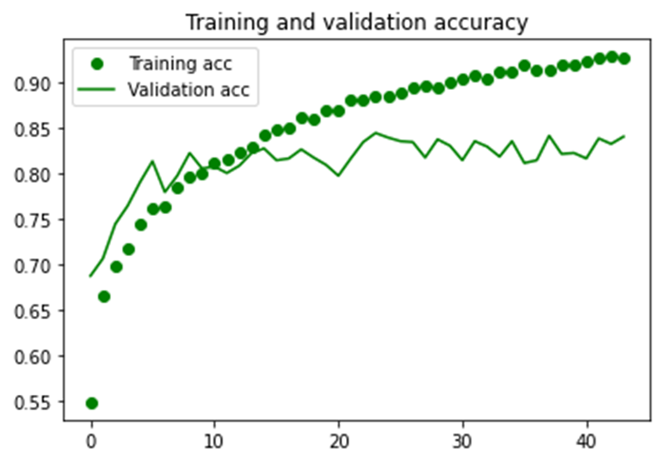
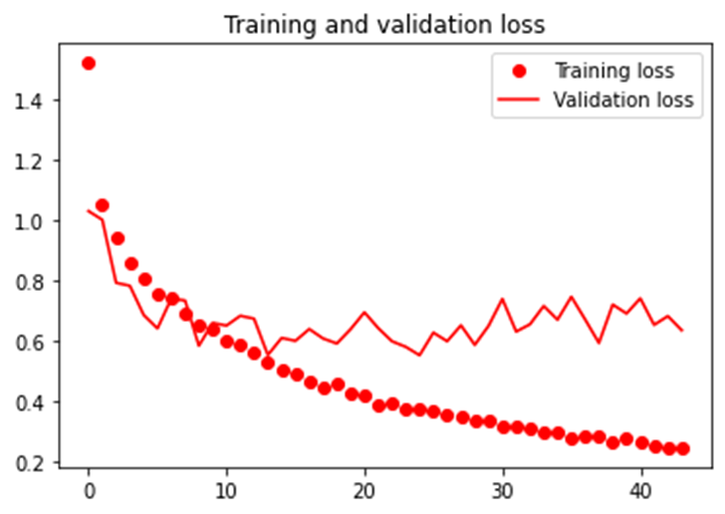
4B - Fine-Tuned MobileNet Model without Data Augmentation
Early Stoppage of 44/60 Epochs with reduced Overfitting Observed
Training Accuracy - 92.63%
Validation Accuracy - 84.00%
Training Loss - 0.2451
Validation Loss - 0.6334
Notes:
[Speaker: Seo Shin Youn]
Thus, as observed from Figure 38 which shows that the model has stopped running further after 44 epochs due to the callback argument we had utilized, we could observe that the Mobile Net model has reached a training and validation accuracy of 92.63% and 84.00% respectively. Additionally, by observing the training and validation loss plot, we could observe that the model has a training loss of 0.2451 with a constant validation loss of 0.6334. Hence, as illustrated from Figure 35, although we could observe that the model is model is still overfitting, the deviation of overfitting has decreased significantly between the training and testing accuracy. Thus, it could be observed that Data Augmentation and hyperparameter tuning plays an effective role in minimizing overfitting.

Slide 31
Evaluating Models
on Test Images
04
Comparison of Model Performances on Test Images and Recommendation of the Best Model
Notes:
[Speaker: Seo Shin Youn]
Now I will be diving deeper into the HR Analytics classification problem, in the order of exploratory data analysis in unit 2.1, data cleansing and transformation in unit 2.2, and the analysis of correlation in unit 2.3.

Slide 32
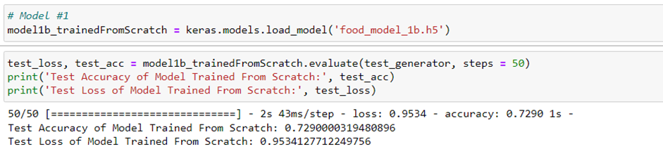
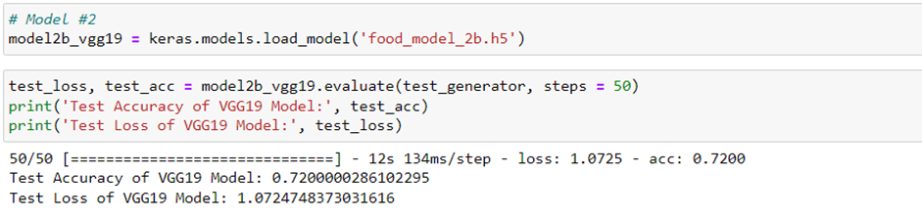
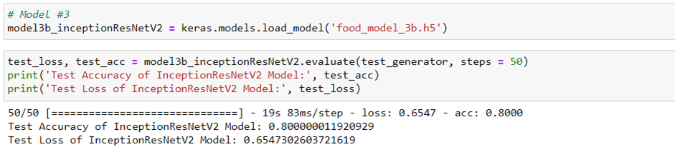
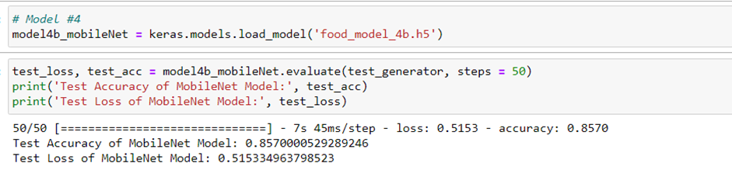
Evaluating Models On Test Images
CNN Model Trained From Scratch
(Test accuracy: 72.90%, Test Loss: 0.95)
Fine-Tuned VGG19 Model with Data Augmentation
(Test accuracy: 72.00%, Test Loss: 1.07)
Best Model: Fine-Tuned MobileNet Model with Data Augmentation
(Test accuracy: 85.70%, Test Loss: 0.515)
Fine-Tuned InceptionResNetV2 Model with Data Augmentation
(Test accuracy: 80.00%, Test Loss: 0.65)
Notes:
Thus, by observing the various models and their respective test accuracy and test loss, we could observe that the MobileNet model would be our recommended model given that it has the highest test accuracy of 85.70% alongside the lowest test loss score of 0.52. Hence, the following model would be able to produce the highest accuracy on unseen images while also having the lowest frequency of misclassification.
The second-best model that we have built and optimized involves the InceptionV2ResNet model which had a second-highest test accuracy of 80% and a second lowest test loss score of 0.66.
The third-best performing model that we have built and optimized involves the model we had trained from scratch which had a third-highest test accuracy of 72.90% alongside the second highest test loss score of 0.95
On the other hand, the worst performing model can be attributed to the VGG19 model which had the lowest test accuracy of 72.00% alongside the highest loss score of 1.07.

Slide 33
Evaluating the Best Model on unseen images
05
Understanding how our recommended model can be applied on real life images alongside analyzing results
Notes:
[Speaker: Seo Shin Youn]
Now I will be diving deeper into the HR Analytics classification problem, in the order of exploratory data analysis in unit 2.1, data cleansing and transformation in unit 2.2, and the analysis of correlation in unit 2.3.

Slide 34


Testing MobileNet mobile on Images From the Internet
MobileNet Performance:
Able to classify image correctly as ‘spring_rolls’
With Accuracy Score of 96.85%
Load Best Model (MobileNet) Saved, Store food items in a list, function to process image and display each food item and their respective prediction probability
Notes:
Hence, to apply the Data Augmented MobileNet model which has been Fine-Tuned on real life images from the internet, we could observe Figure 40 which illustrates the various sequences of process. Hence, from the first line of code, given that we have previously saved the model under ‘food_model_best.h5’, we can load the model back by utilizing the load_model() method. To then review the food items that we have been assigned with, we could make use of the readline() method which would read the text data from ’60.txt’, in which we will append the items into a list named, food_list. Subsequently, we will creating two functions whereby image_process() would load and resize the input image to 224x224 given that our MobileNet model had also been trained using the input image size of 224x224 while the prediction() method would assist in displaying each food item and their respective prediction probability.
To then make a prediction with a food image (i.e., Spring Rolls) we had downloaded from the internet, we could make use of the following lines of command as observed from Figure 41 which would display the label of the image that the MobileNet model has predicted alongside the respective probabilities of each label regarding the image chosen. Thus, from Figure 41, with regards to the spring roll image we have chosen, we could observe that the MobileNet model has been able to correctly classify the food image to its label with a 96.85% accuracy, while the rest of the probabilities is split among other various food items.

Slide 35
Summary
06
Further Improvements that can be made to the model to achieve higher level of accuracy and reduce likelihood of overfitting/underfitting
Notes:
[Speaker: Seo Shin Youn]
Now I will be diving deeper into the HR Analytics classification problem, in the order of exploratory data analysis in unit 2.1, data cleansing and transformation in unit 2.2, and the analysis of correlation in unit 2.3.

Slide 36


Suggestion on Further Improvements
Use of Larger Pre-Trained CNN Models
MixUp Augmentation
Testing Individual Labels
Examples include NasNet-A and Amoeba-A which have larger number of parameters → Higher Accuracy
Utilizing MixUp Augmentation Technique to combine images with ability to control transparency in order to create new images from
Testing model on a single type of food image to understand how well a model classified a particular food type → Remove trial and error of hyperparameter tuning
Notes:
One of the improvements that could be made would be to test on larger pre-trained models. Given that we have already experimented with InceptionResNetV2 which already has over 50 million trainable parameters, we could explore other pre-trained models in the interest of time such as NasNet-A and AmoebaNet-A which are models with larger parameters are able to produce higher level of accuracy as observed from their performance on the ImageNet database.
Additionally, besides the data augmentation technique we have performed including rotating the image, shifting the image vertically and horizontally, and controlling the brightness of the image from ImageDataGenerator, we could make use of MixUp to augment our images in order to further reduce overfitting and increasing overall accuracy. Hence, how this process works would be that two images from the training dataset would be placed on top of one another whereby their transparency could be adjusted to form new images. Hence, this would allow us to improve the generalization of the neural network architecture that we have created.
The last suggestion on further improvements that could be taken would be to instead test on individual types of images on top of tracking the overall accuracy of the model on all types of food. Hence, this would allow us to determine which types of food the model is able to accurately classify while also being able to determine which types of food the model is mostly misclassifying. Thus, this would allow us to make an informed decision on what hyperparameter to tune in order to better classify a certain type of food image rather than performing hyperparameter tuning using trial and error.

Slide 37
Thank You!

